Slide 1
Adulting 101
Understanding Credit Score
College Prep
Mr. Gordon
jgordon@bisdtx.org

Slide 2
Upcoming Events

Slide 3
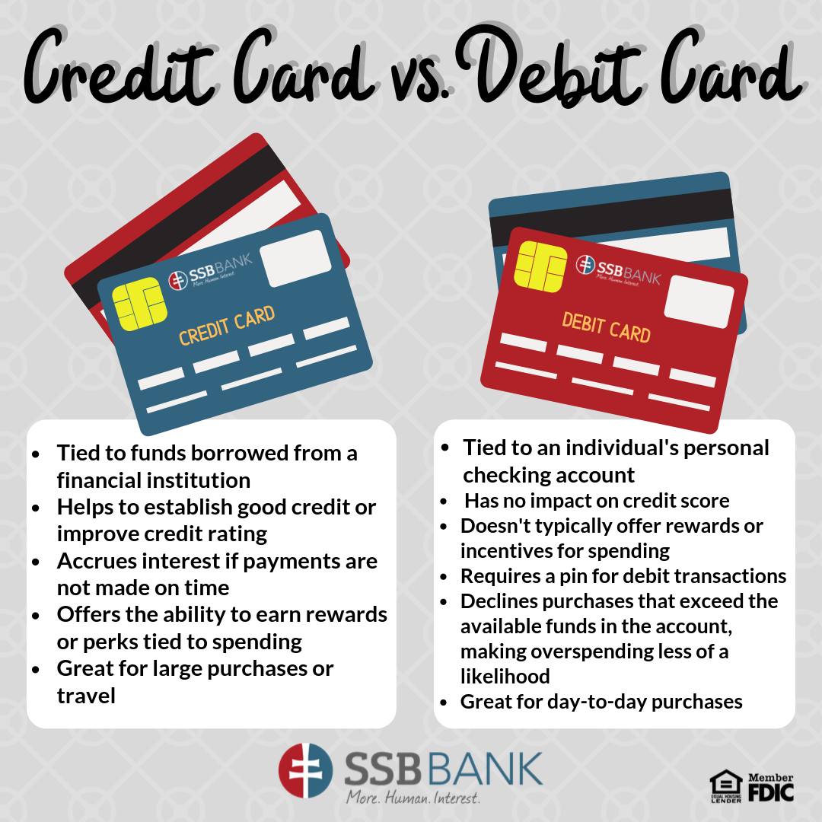
Adulting 101-Credit Score
Credit vs Debit: What’s the difference?

Slide 4
Adulting 101-Credit Score
What is a credit score?
A credit score is the number that represents your creditworthiness.
Creditworthiness is the likelihood that you will repay your debt,
whether it is a car loan,a house, or a student loan.
Credit Score is also commonly referred to as a FICO score, since FICO is the most popular credit score company.

Slide 5
Adulting 101-Credit Score
Credit score is 300-850.
The average credit score in the U.S. in 2023 is 702.
Many students will start with a 500-700 score.
The higher your credit score the more likely you are to get a loan and a lower interest rate.
This can save you thousands of dollars in payments to the bank or credit card company. See next slide.

Slide 6
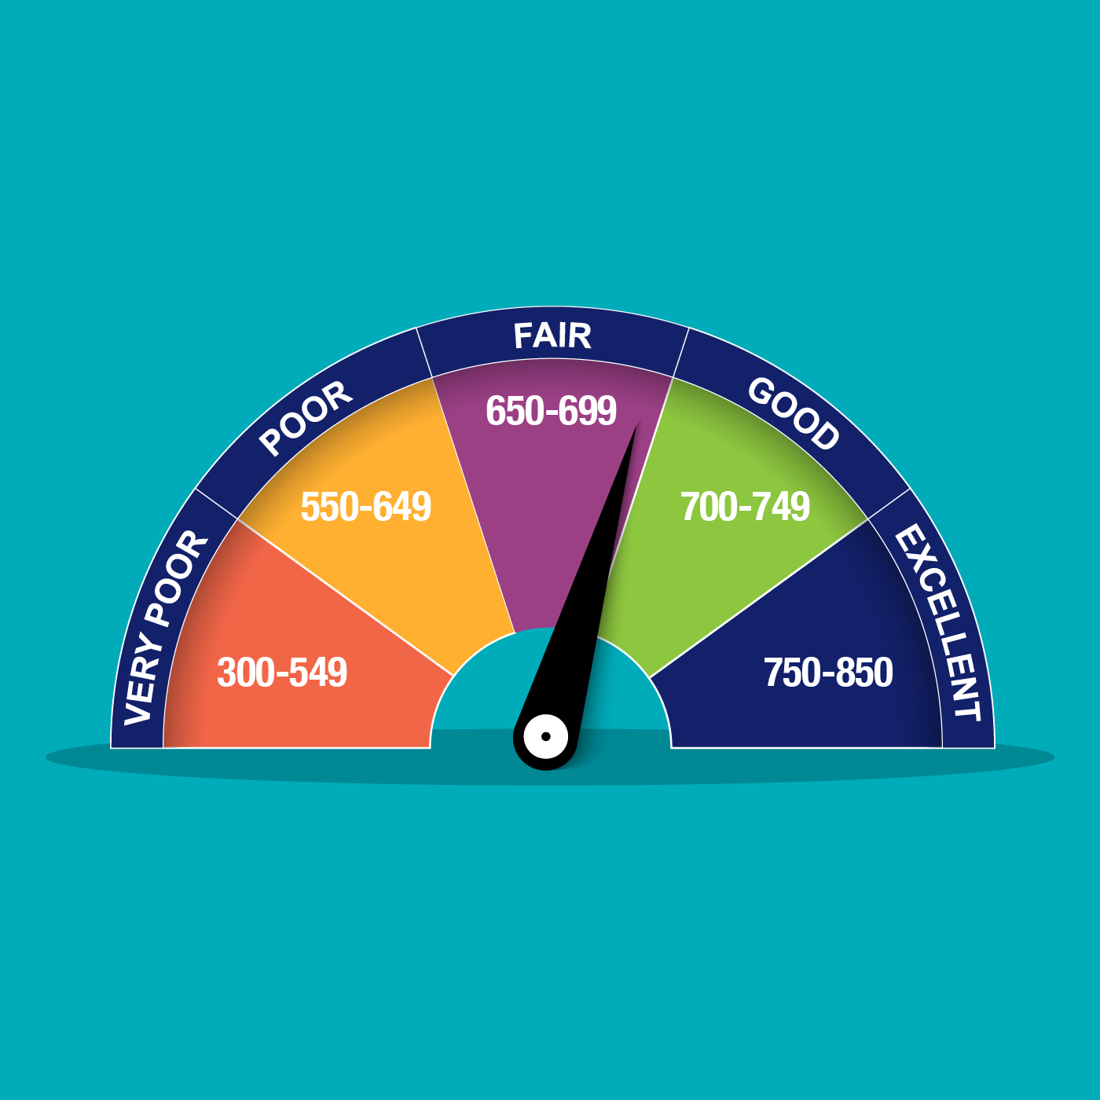
Adulting 101-Credit Score

Slide 7
Adulting 101-Credit Score
The average mortgage rate on a 30 year fixed is 7.82% as of Nov. 28, 2023. The median home price in Bastrop County as of October 2023 is $379,495. Monthly payment of $2,505 with 20% down at $75,899. Equals
Mortgage Size $303,596
Mortgage Interest $484,697
Total Paid $788,293

Slide 8
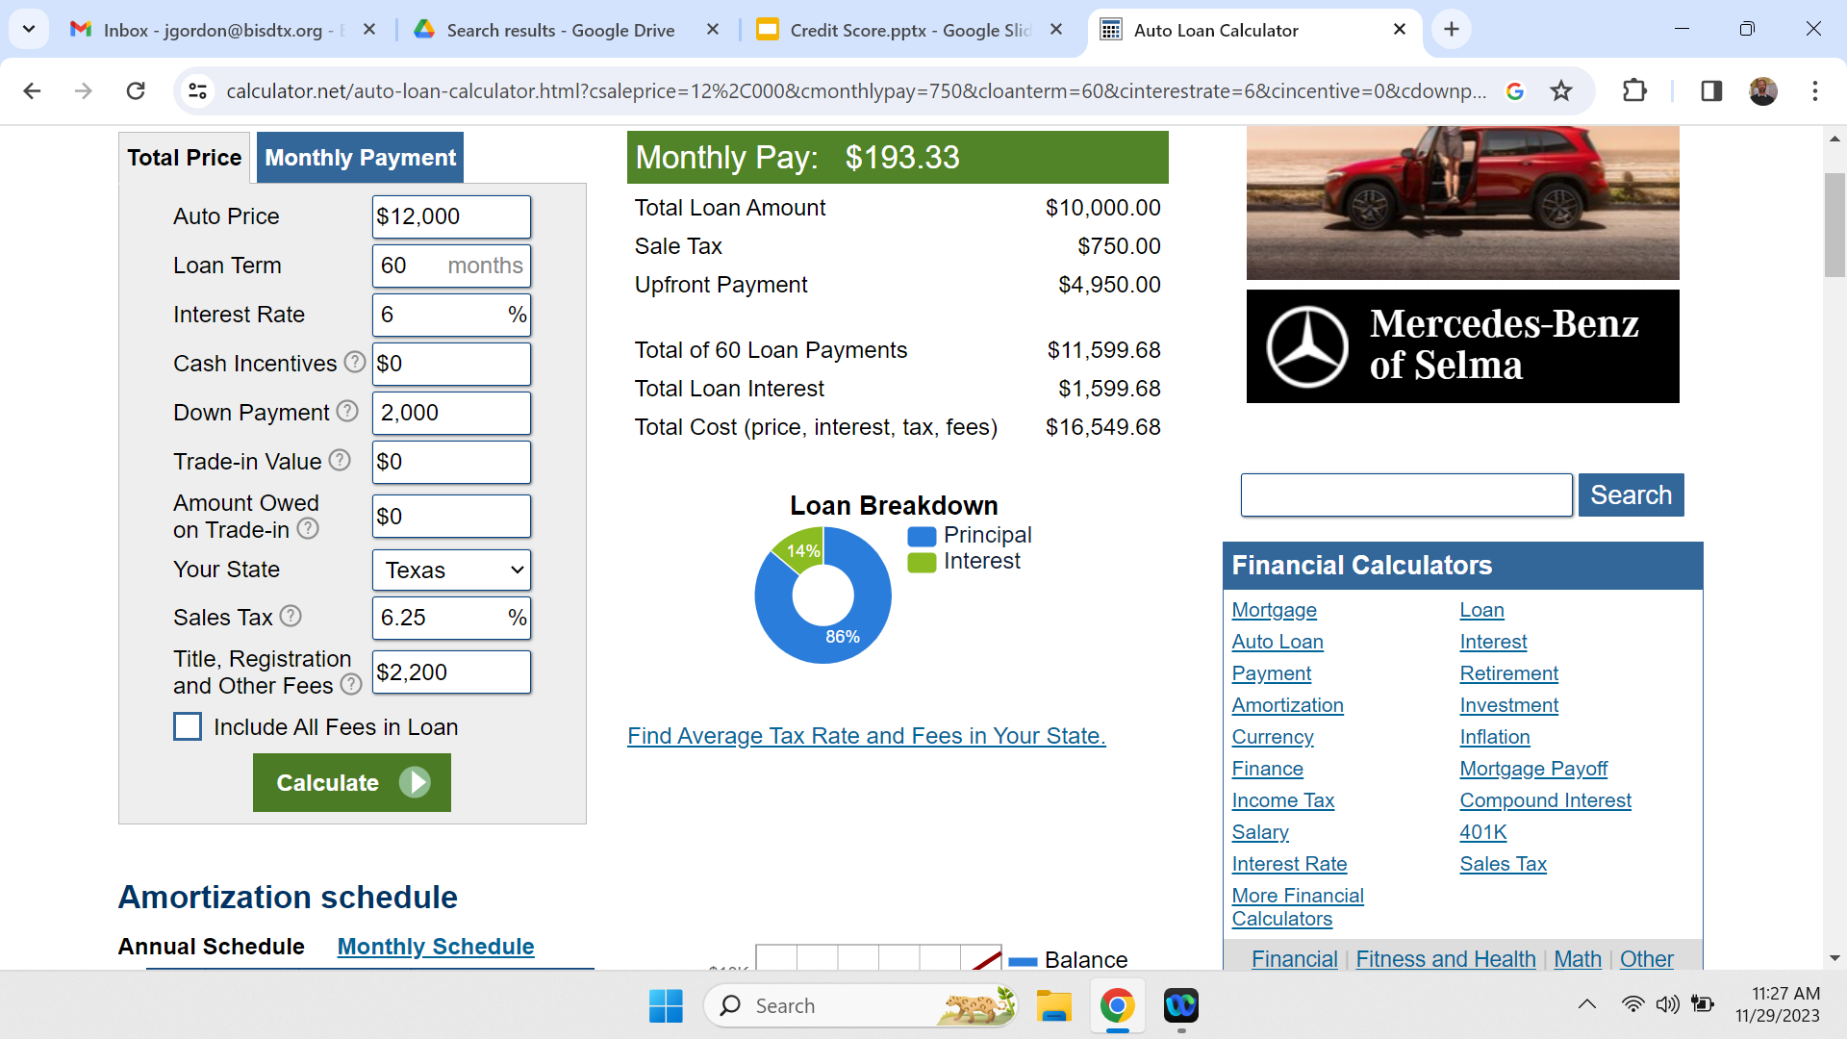
Adulting 101-Credit Score

Slide 9
Adulting 101-Credit Score
If you have a low credit score, it may prevent you from getting a loan at all. Also, some companies will run credit scores for potential employees.
Most students have to take out a loan to help pay for college. This loan can be through the government or through a bank.
When students sign up for these loans, sometimes it will ask for a co-signer. This can be a parent or guardian. A co-signer promises that if you are unable to pay the loan, they are responsible for paying it on your behalf.

Slide 10
Adulting 101-Credit Score
Your credit score is an algorithm based on:
35% Payment History- How you have paid your bills- whether on time, late, or missed.
30% Amount of Debt- Total owed, how many accounts have balances, and how much of your available credit you are using.
15% Length of Credit History- Average age of all your account
10% Amount of New Credit- How many accounts you have recently opened or applied for.
10% Credit Mix- Different types of accounts being used.

Slide 11
Adulting 101-Credit Score
You can run a credit report for free once a year from the 3 major companies- Experian, Equifax, and Transunion.
This is to verify that everything is current, correct, and not fraudulent.

